Slide 1


Slide 2
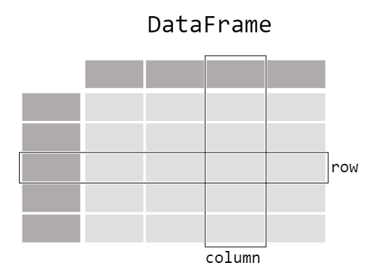

Slide 3
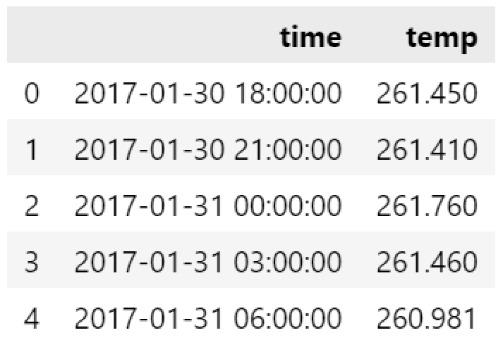
DataFrames
pandas1.py
import pandas as pd
df = pd.DataFrame(
{'time':time,
'temp':temp}
)
df.time = pd.to_datetime(time,unit='s')
df.head()

Slide 4
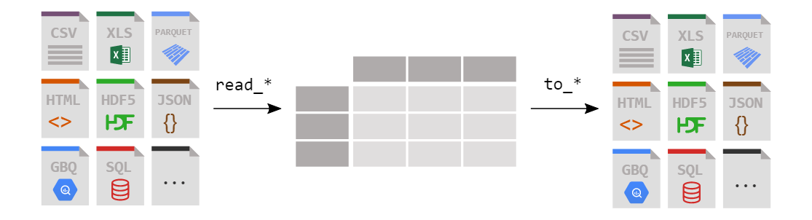
How do I read and write tabular data?
https://pandas.pydata.org/docs/getting_started/intro_tutorials/02_read_write.html#min-tut-02-read-write
Notes:
Parquet >> probably the most efficient way to exchange dataframe with MATLAB Table

Slide 5

How do I select a subset of a table?
https://pandas.pydata.org/docs/getting_started/intro_tutorials/03_subset_data.html#min-tut-03-subset

Slide 6
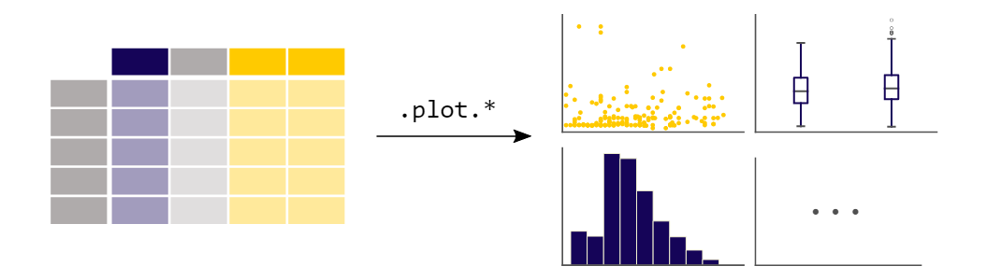
How to create plots in pandas?
https://pandas.pydata.org/docs/getting_started/intro_tutorials/04_plotting.html#min-tut-04-plotting

Slide 7
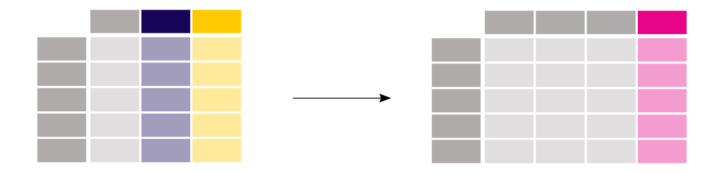
How to create new columns derived from existing columns?
https://pandas.pydata.org/docs/getting_started/intro_tutorials/05_add_columns.html#min-tut-05-columns
Notes:
There is no need to loop over all rows of your data table to do calculations. Data manipulations on a column work elementwise. Adding a column to a DataFrame based on existing data in other columns is straightforward.

Slide 8
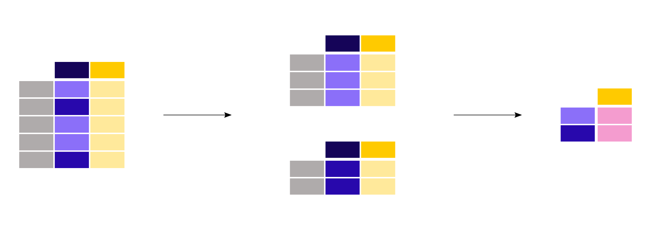
How to calculate summary statistics?
https://pandas.pydata.org/docs/getting_started/intro_tutorials/06_calculate_statistics.html#min-tut-06-stats

Slide 9

How to reshape the layout of tables?
https://pandas.pydata.org/docs/getting_started/intro_tutorials/07_reshape_table_layout.html#min-tut-07-reshape

Slide 10
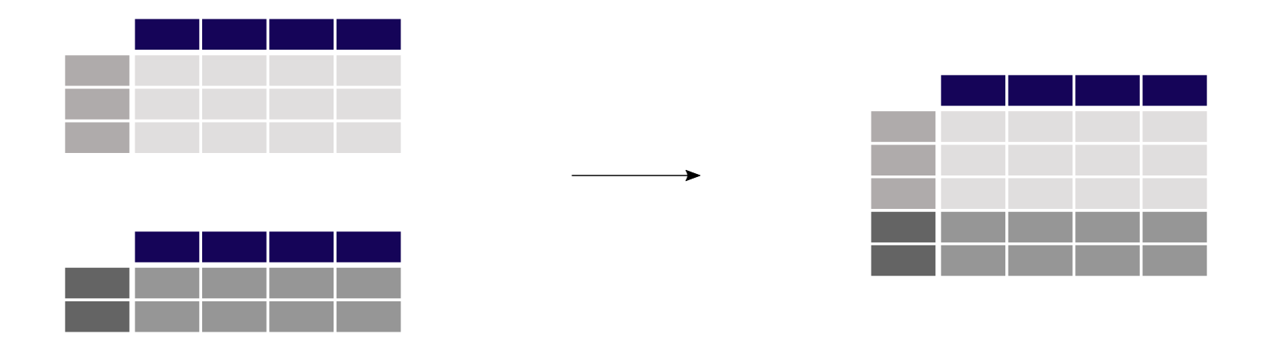
How to combine data from multiple tables?
https://pandas.pydata.org/docs/getting_started/intro_tutorials/08_combine_dataframes.html#min-tut-08-combine

Slide 11
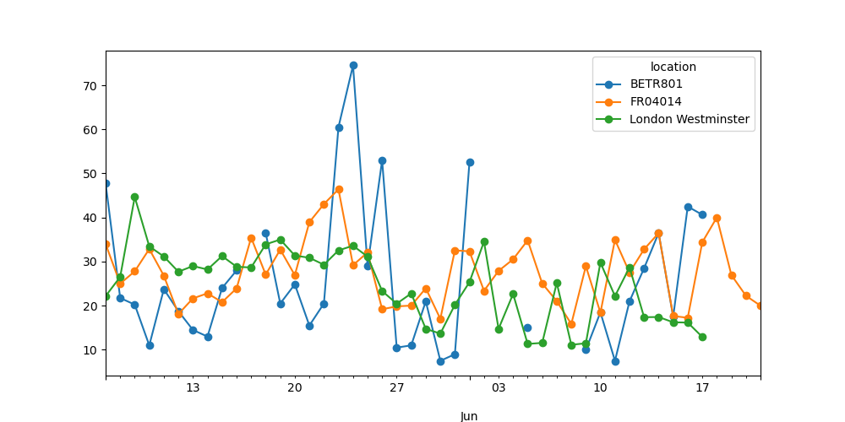
How to handle time series data?
https://pandas.pydata.org/docs/getting_started/intro_tutorials/09_timeseries.html#min-tut-09-timeseries

Slide 12
Read more

Slide 13
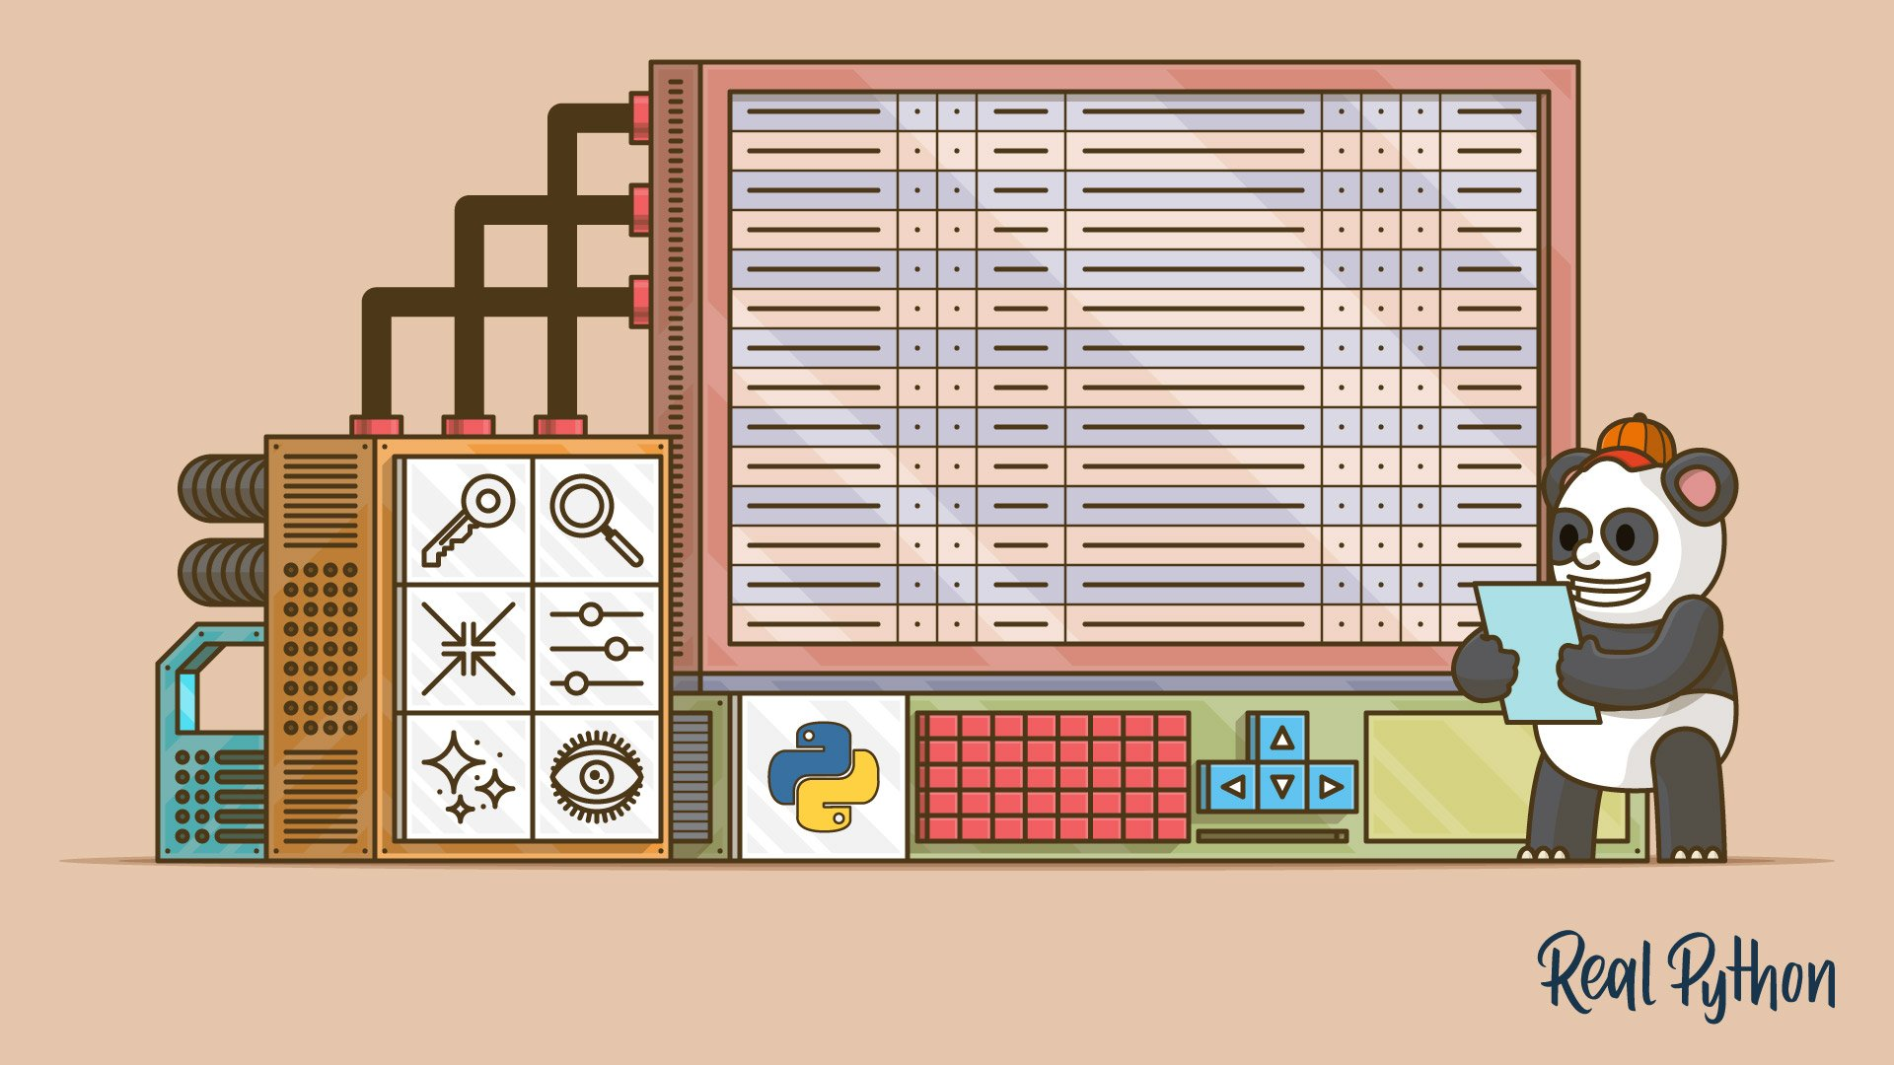
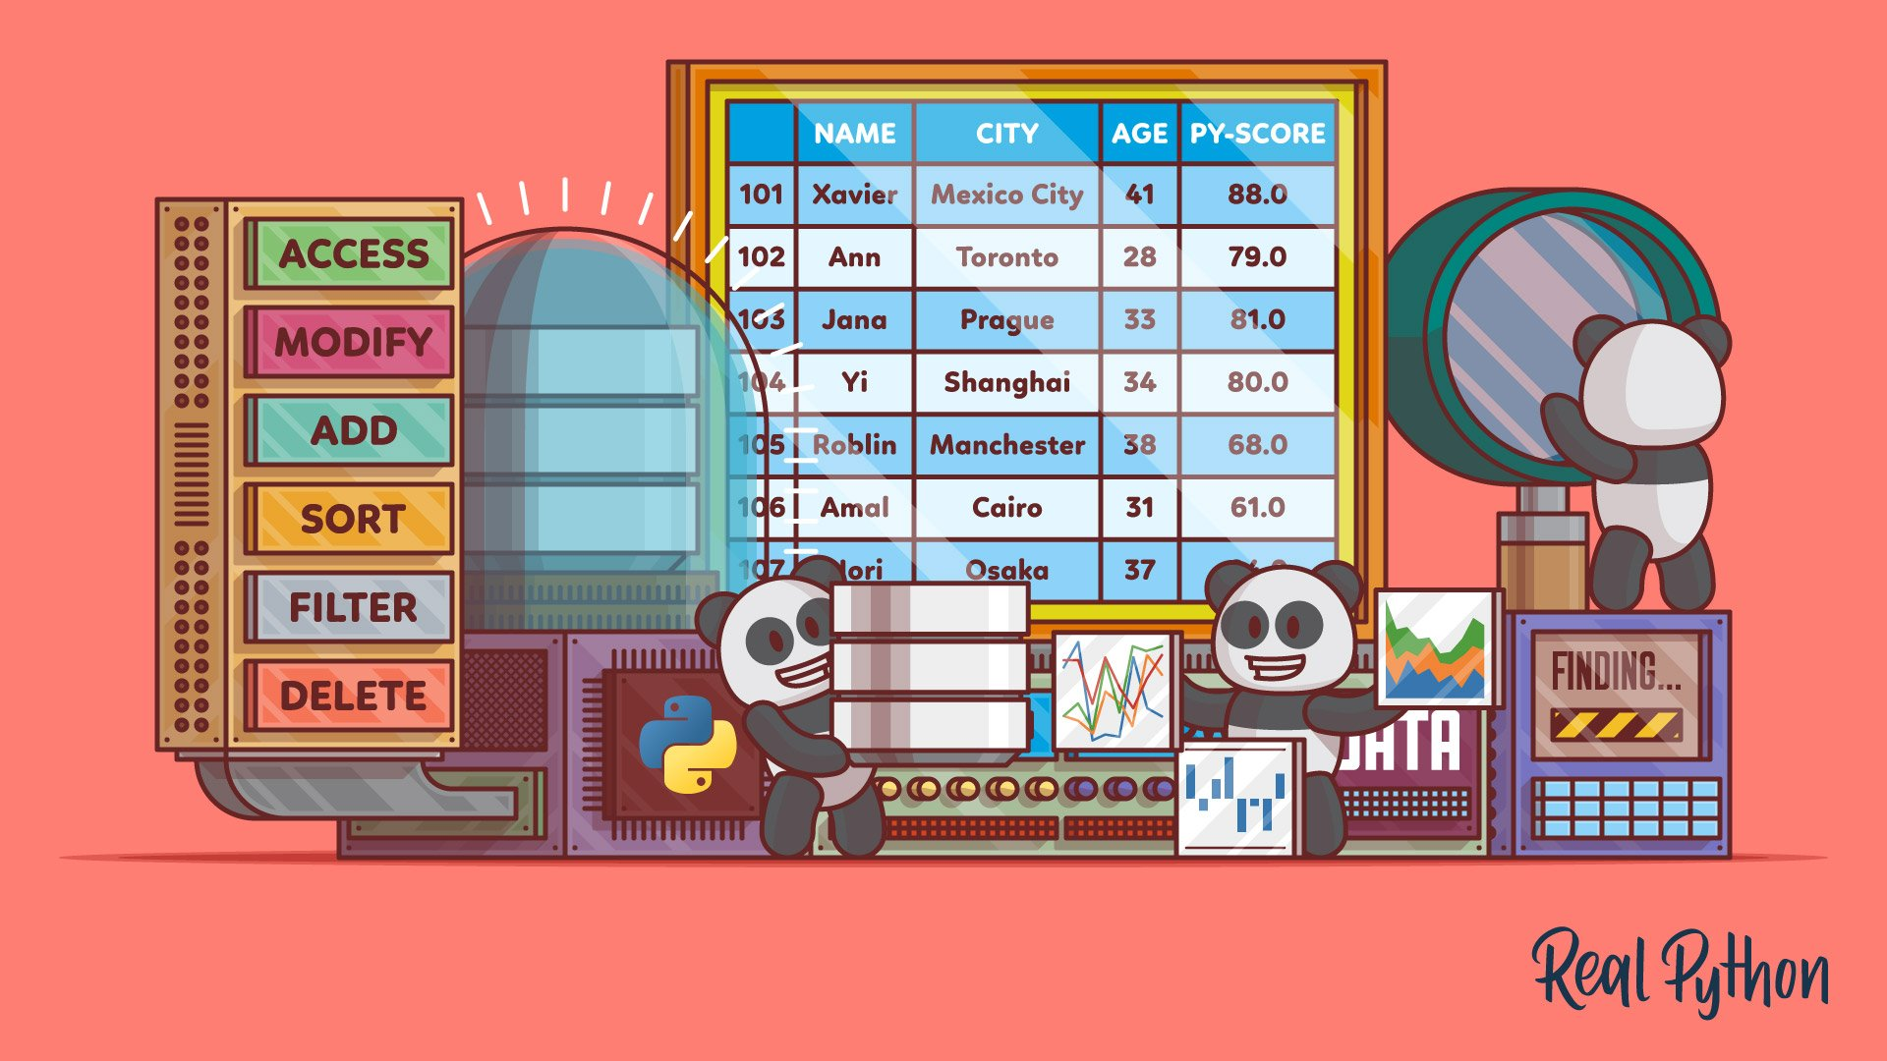
More on Pandas
https://realpython.com/pandas-python-explore-dataset/
https://realpython.com/pandas-dataframe/

Slide 14


More on Pandas (2)
merge, join, and concat
GroupBy
https://realpython.com/pandas-merge-join-and-concat/
https://realpython.com/pandas-groupby/

